Slide 1

CPU Scheduling
Lecturer: VU THI MY HANG
Operating System

Slide 2
Plan
Basic concepts
Scheduling algorithms

Slide 3
Plan
Basic concepts
Scheduling algorithms

Slide 4
CPU – I/O Burst Cycle
Basic concepts
A process execution alternates between:
CPU Burst performing calculations
I/O Burst performing I/O operations
CPU
P1
Idle
P1
Idle
P1
I/O
P1
P1
CPU Burst
I/O Burst
CPU Burst
I/O Burst
CPU Burst

Slide 5
Scheduling Procedure
Basic concepts
Time slice expired
Job pool
Exit
Ready Queue
CPU
Dispatcher
Long term scheduler
Short term scheduler
Medium term scheduler
Waiting Queue
Scheduler
Scheduler is an OS component involving scheduling activities, which consists of:
Long term scheduler (Job scheduler) selects jobs from the job pool and loads them into the memory (ready queue) for execution
Notes:
When a process enters into a system, they are added into a job pool. This pool consists of all the processes in the system. Job scheduler also called as Long Term Scheduler, takes the job or process from Job-pool and puts in the ready queue.
This queue consists of processes which are residing in the main memory and are ready and waiting to execute. CPU Scheduler or Short Term Scheduler takes the process from Ready queue and puts in the the CPU for execution. The process to be put in the CPU is decided by a Scheduling Algorithm.
Device Queue
This queue contains the processes which are waiting for the completion of I/O request. Each device has its own device queue.

Slide 6
Scheduling Procedure (cont.)
Basic concepts
Time slice expired
Job pool
Exit
Ready Queue
CPU
Dispatcher
Long term scheduler
Short term scheduler
Medium term scheduler
Waiting Queue
Scheduler
Scheduler is an OS component involving scheduling activities, which consists of:
Short term scheduler (CPU scheduler) selects a process to be executed among ready processes
Notes:
When a process enters into a system, they are added into a job pool. This pool consists of all the processes in the system. Job scheduler also called as Long Term Scheduler, takes the job or process from Job-pool and puts in the ready queue.
This queue consists of processes which are residing in the main memory and are ready and waiting to execute. CPU Scheduler or Short Term Scheduler takes the process from Ready queue and puts in the the CPU for execution. The process to be put in the CPU is decided by a Scheduling Algorithm.
Device Queue
This queue contains the processes which are waiting for the completion of I/O request. Each device has its own device queue.

Slide 7
Scheduling Procedure (cont.)
Basic concepts
Time slice expired
Job pool
Exit
Ready Queue
CPU
Dispatcher
Long term scheduler
Short term scheduler
Medium term scheduler
Waiting Queue
Scheduler
Scheduler is an OS component involving scheduling activities, which consists of:
Medium-term scheduler handles swapped in and swapped out processes
Notes:
When a process enters into a system, they are added into a job pool. This pool consists of all the processes in the system. Job scheduler also called as Long Term Scheduler, takes the job or process from Job-pool and puts in the ready queue.
This queue consists of processes which are residing in the main memory and are ready and waiting to execute. CPU Scheduler or Short Term Scheduler takes the process from Ready queue and puts in the the CPU for execution. The process to be put in the CPU is decided by a Scheduling Algorithm.
Device Queue
This queue contains the processes which are waiting for the completion of I/O request. Each device has its own device queue.

Slide 8
Scheduling Procedure (cont.)
Basic concepts
Time slice expired
Job pool
Exit
Ready Queue
CPU
Dispatcher
Long term scheduler
Short term scheduler
Medium term scheduler
Waiting Queue
Dispatcher
Allocates CPU to the process selected by Short term scheduler
Notes:
When a process enters into a system, they are added into a job pool. This pool consists of all the processes in the system. Job scheduler also called as Long Term Scheduler, takes the job or process from Job-pool and puts in the ready queue.
This queue consists of processes which are residing in the main memory and are ready and waiting to execute. CPU Scheduler or Short Term Scheduler takes the process from Ready queue and puts in the the CPU for execution. The process to be put in the CPU is decided by a Scheduling Algorithm.
Device Queue
This queue contains the processes which are waiting for the completion of I/O request. Each device has its own device queue.

Slide 9
Scheduling criteria
Basic concepts
Fairness and efficiency
Maximize CPU utilization
Maximize throughput
Throughput is the number of processes completed per unit time
Minimize turnaround time, waiting time, and response time
Turnaround time is the interval from the time of process submission to the time of process completion
Waiting time is the interval in the ready queue
Response time is the interval from the time of process submission to the time of producing the first response

Slide 10
When to schedule ...
Basic concepts
New process created
Execute parent or child process?
Process terminates
Process blocked for an I/O operation or an event
Interrupt occurring
Completion of I/O operation
End of time slice
Which is the next process to execute?

Slide 11
Scheduling Types
Basic concepts
In Nonpreemptive scheduling, the running process keeps the CPU until it terminates or switches to the waiting state (by an I/O completion or an event)
In Preemptive scheduling (i.e., cooperative scheduling), the running process may be suspended by the OS because of a higher priority process arriving or its time slice expired

Slide 12
Plan
Basic concepts
Scheduling algorithms

Slide 13
First-Come, First-Served (FCFS) Scheduling
Scheduling algorithms
Nonpreemptive scheduling
Pick the first process standing in ready queue for execution
☺ Simplicity
Low performance
Do not consider process priority
Exit
Ready Queue
CPU
...
P3
P2
P1

Slide 14
First-Come, First-Served (FCFS) Scheduling (cont.)
Scheduling algorithms
Process | Arrival Time | CPU Burst | TT | WT
P1 | 0 | 24
P2 | 1 | 5
P3 | 2 | 3
24 | 0
28 | 23
30 | 27
AVG_{TT} = 27.33 | AVG_{WT} = 16.67
P1 | P2 | P3
0 | 24 | 29 | 32
Turnaround Time (TT) = (Completion Time – Arrival Time)
Waiting Time (WT) = (TT – CPU Burst)
E.g., TT(P3) = 32 – 2 = 30, WT(P3) = 30 – 3 = 27

Slide 15
Round-Robin (RR) Scheduling
Scheduling algorithms
Preemptive scheduling
Especially used in timesharing systems
Pick the first process standing in ready queue for execution within a given time quantum q (time slice)
After the time quantum, if the active process has not finished yet, it will move to the end of the ready queue for the next execution
Exit
Ready Queue
CPU
...
P3
P2
P1
Time quantum expired

Slide 16
Round-Robin (RR) Scheduling (cont.)
Scheduling algorithms
Fairness
Reduce waiting time of short CPU-burst processes
Do not consider process priority
How to define time quantum?
Too large time quantum → Similar to FIFO Algorithm
Too low time quantum → Too many context switches performed

Slide 17
Round-Robin (RR) Scheduling (cont.)
Scheduling algorithms
Process | Arrival Time | CPU Burst | TT | WT
P1 | 0 | 24
P2 | 1 | 5
P3 | 2 | 3
32-0 = 32 | 32-24 = 8
16-1 = 15 | 15-5 = 10
11-2 = 9 | 9-3 = 6
AVG_{TT} = 18.66 | AVG_{WT} = 8
Another method for calculating WT
WT(P1) = (11 – 4) + (16 – 15) = 7 + 1 = 8
WT(P2) = (4 – 1) + (15 – 8) = 3 + 7 = 10; WT(P3) = (8 – 2) = 6
q = 4
P1 | P2 | P3 | P1 | P2 | P1
0 | 4 | 8 | 11 | 15 | 16 | 32

Slide 18
Shortest-Job-First (SJF) Scheduling
Scheduling algorithms
Nonpreemptive scheduling
Preemptive version: Shortest-Remaining-Time-Next (SRTN) Scheduling
Pick the process having the smallest CPU-bursts time
Exit
Ready Queue
CPU
...
P3 (8s)
P2
(3s)
P1
(9s)
What if P4(2s) is put into the ready queue while P2 is running?
SJF: P2 continues its execution then CPU switches to P4
SRTN: P4 will be preempted immediately

Slide 19
Shortest-Job-First (SJF) Scheduling (cont.)
Scheduling algorithms
Simplicity
Reduce turnaround time and waiting time of “short” processes
Increase throughput (i.e., more processes completed)
Need to estimate CPU-burst of all processes
Problem of starvation
Processes having higher CPU-burst can be blocked indefinitely if smaller CPU-burst processes keep executing

Slide 20
Shortest-Remaining-Time-Next (SRTN) Scheduling
Scheduling algorithms
Process | Arrival Time | CPU Burst | TT | WT
P1 | 0 | 24
P2 | 1 | 5
P3 | 2 | 3
32-0 = 32 | 32-24 = 8
9-1 = 8 | 8-5 = 3
5-2 = 3 | 3-3 = 0
AVG_{TT} = 14.33 | AVG_{WT} = 3.66
P1 | P2 | P3 | P2 | P1
0 | 1 | 2 | 5 | 9 | 32

Slide 21
Priority Scheduling
Scheduling algorithms
Two versions: preemptive and nonpreemptive scheduling
Especially used in timesharing systems
Each process is associated with a priority
Pick the process having the highest priority in the ready queue
What if a new process having higher priority than the currently executing process arrives?
Preemptive version: the running process will be stopped immediately
Nonpreemptive version: the running process finishes its task then the highest priority process will be allocated the CPU

Slide 22
Priority Scheduling (cont.)
Scheduling algorithms
Take consideration of process priority
Problem of starvation
Processes having lower priority can be blocked indefinitely if higher priority processes keep executing
Solutions for the starvation problem:
Aging (i.e., increase the priority of processes waiting for a long time in the ready queue)

Slide 23
Priority Scheduling (cont.)
Scheduling algorithms
Process | Arrival Time | CPU Burst | Priority | TT | WT
P1 | 0 | 24 | 3
P2 | 1 | 5 | 2
P3 | 2 | 3 | 1
 | P3 > P2 > P1 | P3 > P2 > P1
32-0 = 32 | 32-24 = 8
9-1 = 8 | 8-5 = 3
5-2 = 3 | 3-3 = 0
AVG_{TT} = 14.33 | AVG_{WT} = 3.66
Preemptive version
P1 | P2 | P3 | P2 | P1
0 | 1 | 2 | 5 | 9 | 32

Slide 24
Multilevel Priority Queue Scheduling
Scheduling algorithms
Separate the ready queue into multiple priority queues
Each priority queue is associated with a priority level
Each queue has its scheduling algorithms
Each process is assigned to one queue
Pick processes presenting in higher priority queue first
Process selection is based on the scheduling algorithm applied to this queue

Slide 25
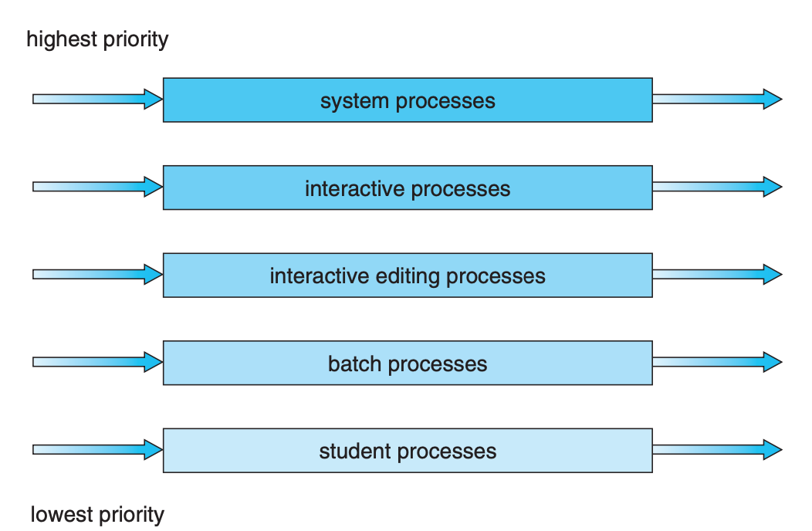
Multilevel Queue Scheduling (cont.)
Scheduling algorithms

Slide 26
And other ...
Scheduling algorithms
Guaranteed scheduling
Lottery scheduling
Fair-Share scheduling

Slide 27

Topic 1

